Slide 1
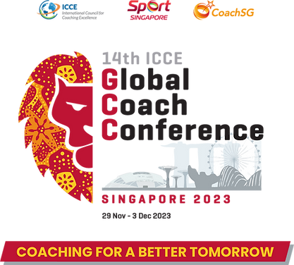
The Association for the Advancement of Status and Rights of Sport Coaches and Physical Trainers
The Coaches Survey
Uri Schaefer (Ph.D.) ICA Executive Director
ICSSPE President
ICCE Past President
Thursday, 30th. 11.2023, Singapore

Slide 2
Content
Preface – The establishment of the Israeli Coaching Association.
The Coaches Survey
Summary and Recommendations.

Slide 3
THE ASSOCIATION FOR ADVANCEMENT OF THE STATUS AND RIGHTS OF COACHES IN SPORTS AND PHYSICAL TRAINING(R.A.)
Established: 6.5.2021
www.meamnim,org

Slide 4
Aim of the survey: To learn about the demographic, educational, and professional characteristics of coaches in Israel and the possible relationships between them.
Method
The study was based on a convenience sample and sent to 1250 coaches,.416 coaches returned the questionnaire. (33.28%).Out of them 313 male, and 103 female coaches and instructors. representing 51 sports disciplines in Israel with the exception of the football coaching association which decided not to participate and a dispute in the Swimming association prevented the swimming coaches from participating..
The questionnaire was based on 39 questions:
5 questions were about personal and demographic details.
29 multiple-choice questions.
5 open questions.

Slide 5
416 Coaches from 51 sports participated in the survey

Slide 6
Statistical analysis was performed by using the following methods:
Descriptive Statistics.
Kruskal Wallis – For one-way analysis of variance.
Chi-squared test.
Fisher's Exact Test.
Spearman's rank correlation coefficient
Kendall correlation coefficient
Some of the sports variables were united to reduce the number of groups to determine better the significance of the results. (Ball Games were classified by Football, Basketball, and all other ball games = in one category. The places of residence were grouped into North Central and South).

Slide 7
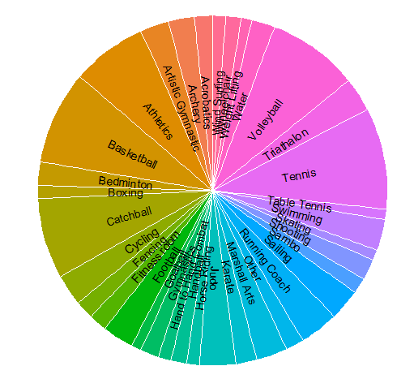
Participation in the survey in Tennis, Volleyball, Basketball, and Triathlon stands out

Slide 8
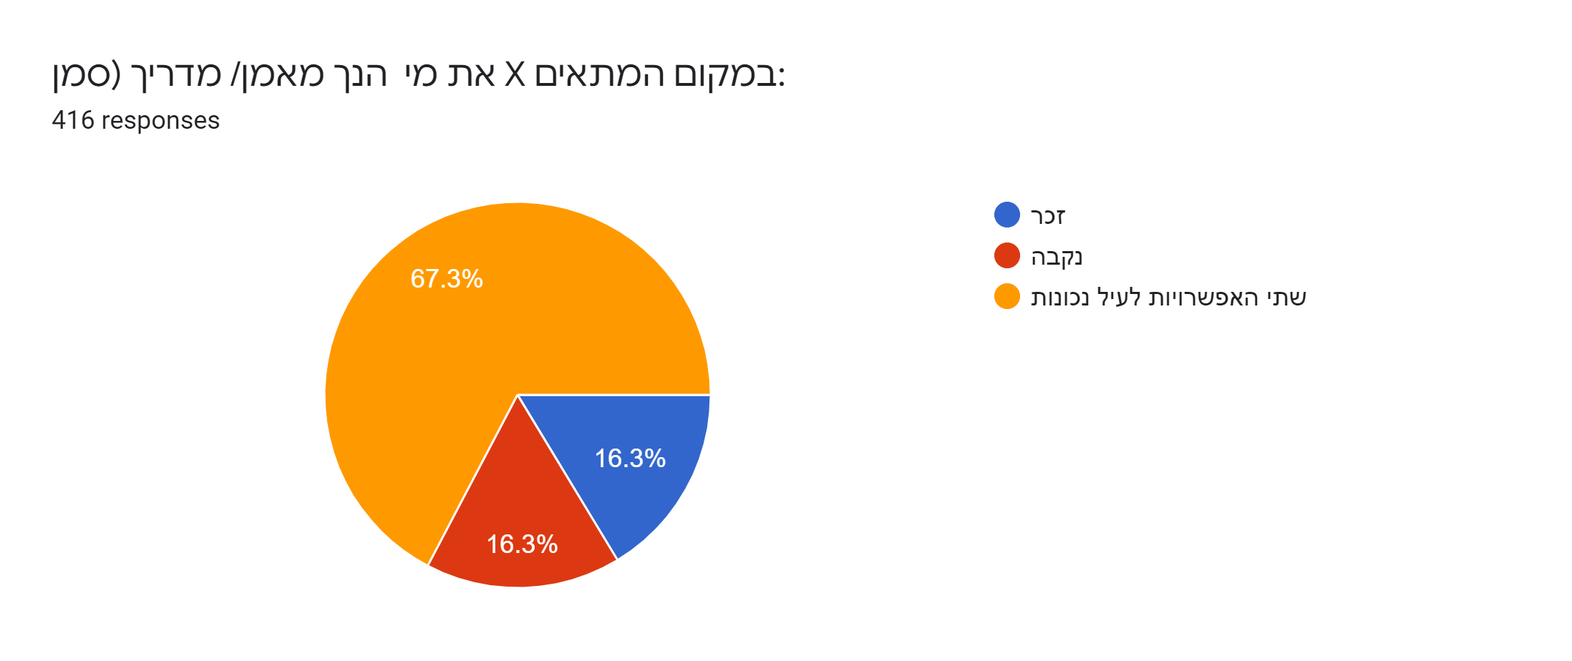
Who do you coach?
Male
Fenale
Both

Slide 9
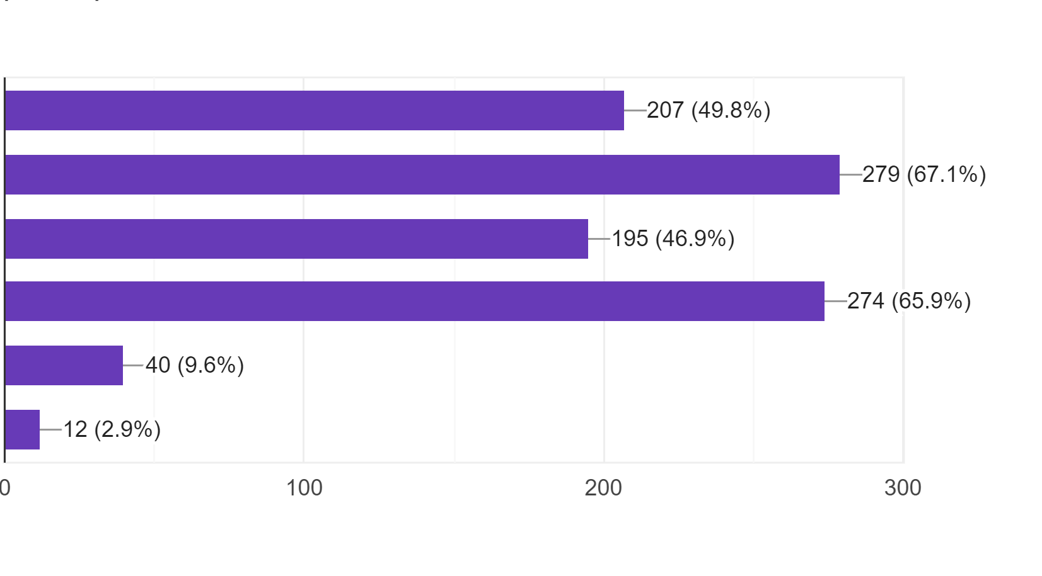
What is the age of the athletes you coach?
Kids up to age 12
Youth age 12 - 16
Youth age 17 - 20
Seniors age 20 +
Retired athletes
I am not coaching

Slide 10
What is your seniority in coaching a sport?
More than 15 years
Between10 & 15 years
Between 5 & 10 years
Less than 5 years

Slide 11
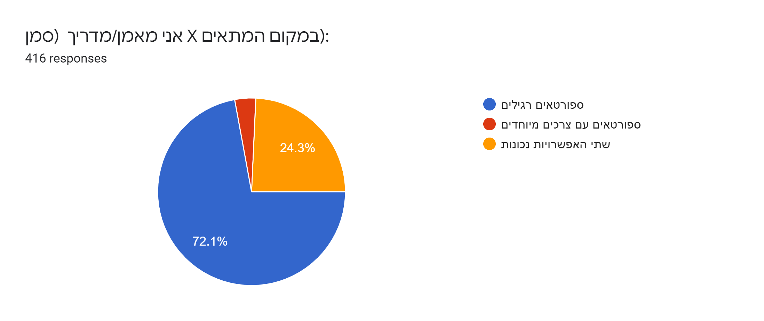
I Coach:
Ordinary Athletes
Athletes with special needs
Both Athletes

Slide 12
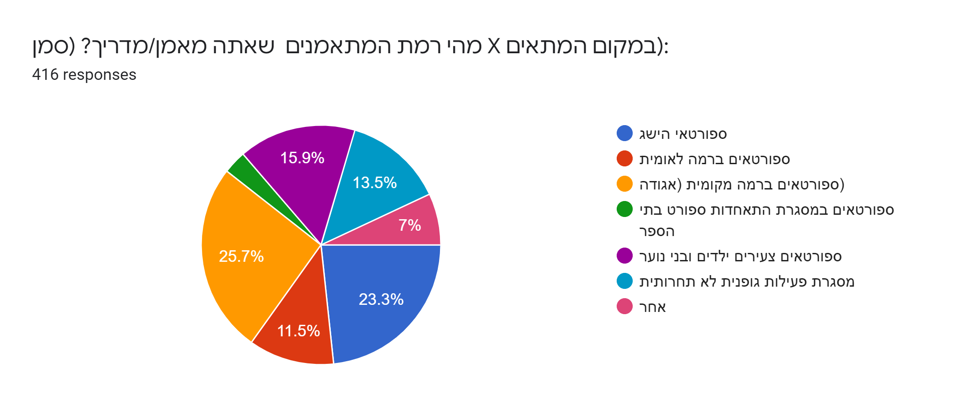
What is the level of your Athletes?
HPA
National level Athletes
Local Athletes
SSF Athletes
Junior Athletes
Noncompetitive Athletes
Other

Slide 13
What is your level of satisfaction with the process of your Coaches Education Program? 1 - not satisfied at all, 5 - Very satisfied.

Slide 14
What is your level of satisfaction with the frequency of in-service training today
in the sport you are active in?

Slide 15
My main place of work
Private Sport Club
Local Authority
Community Center
School Sport Fed.
Wingate Institute
Coaching School
Privately
Other

Slide 16
Scope of my work as a coach?
(Full-time is 42 hours a week)
Full Time
Part-Time
More than Full-time
I am a volunteer

Slide 17
Do you have an employment contract with your employer?
Yes
No
Self Employed

Slide 18
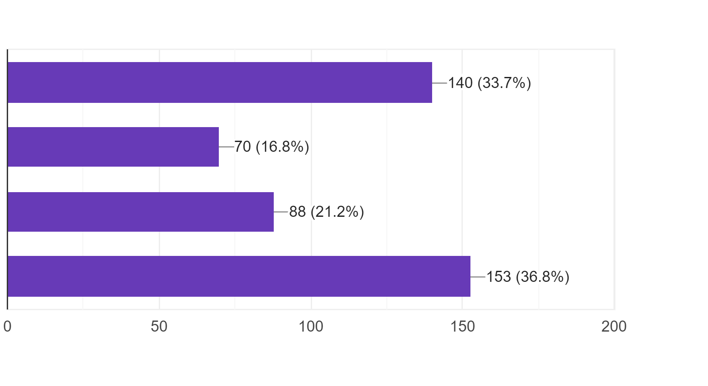
If you have a contract /employment agreement, is it:
For 12 month
More than 12 months
Less than 12 months
Self employed

Slide 19
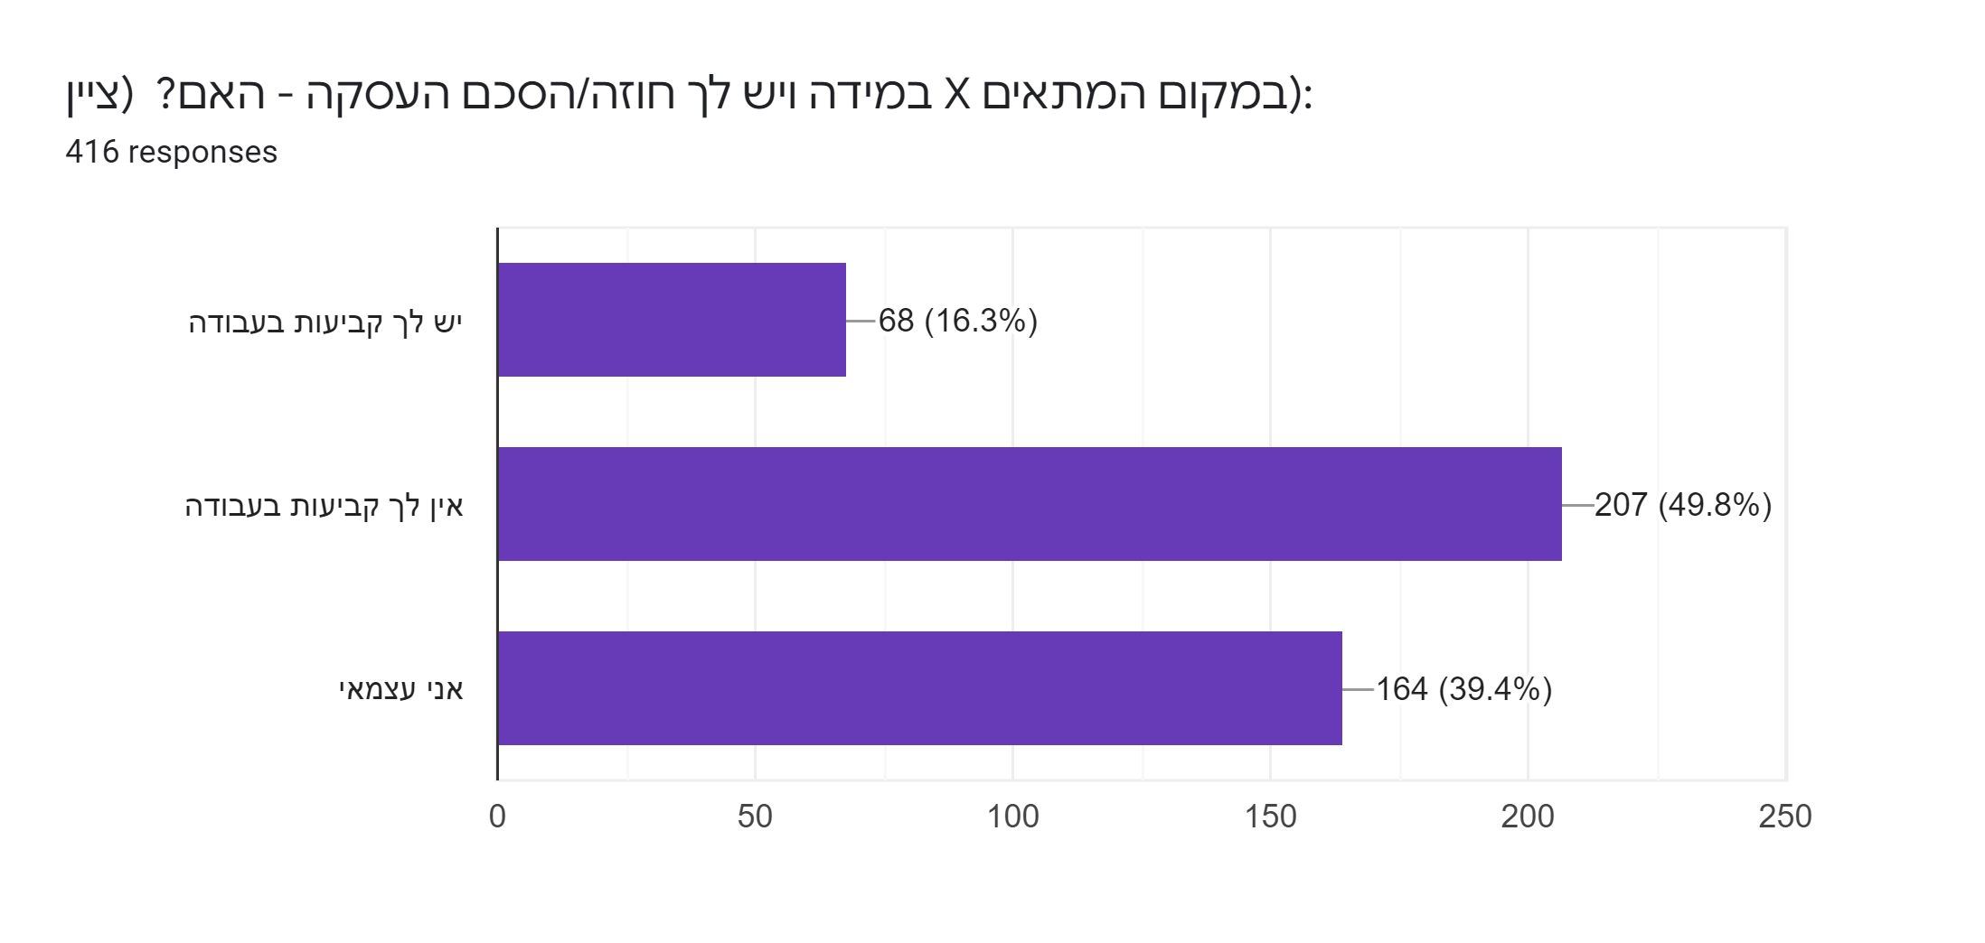
If you have a contract / employment agreement do you?
Have a permanent job
Don’t have a permanent job
I’m self-employed

Slide 20
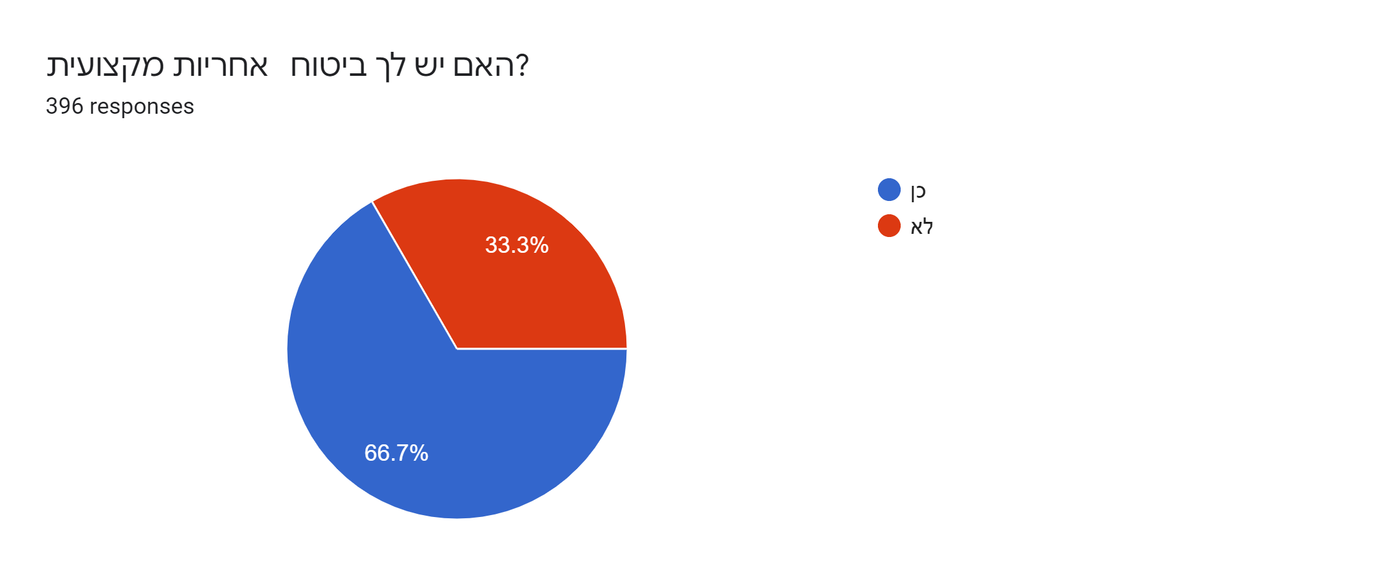
Do you have professional liability insurance?
Yes
No

Slide 21
If you do not have professional liability insurance, would you consider joining the professional liability insurance recommended by the Israeli Coaches Association?
Yes
No
Have not decided yet
First option - Yes

Slide 22
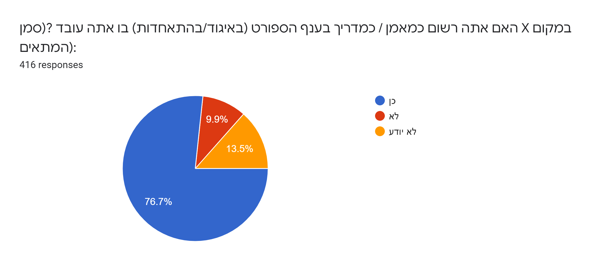
Are you registered with the Sport Association where you work?
Yes
No
Don’t know

Slide 23
Do you have an academic education in one of the fields of sports and physical activity, for example a physical education teacher or in sports science, for example Exercise Physiolosigy?
Yes
No

Slide 24
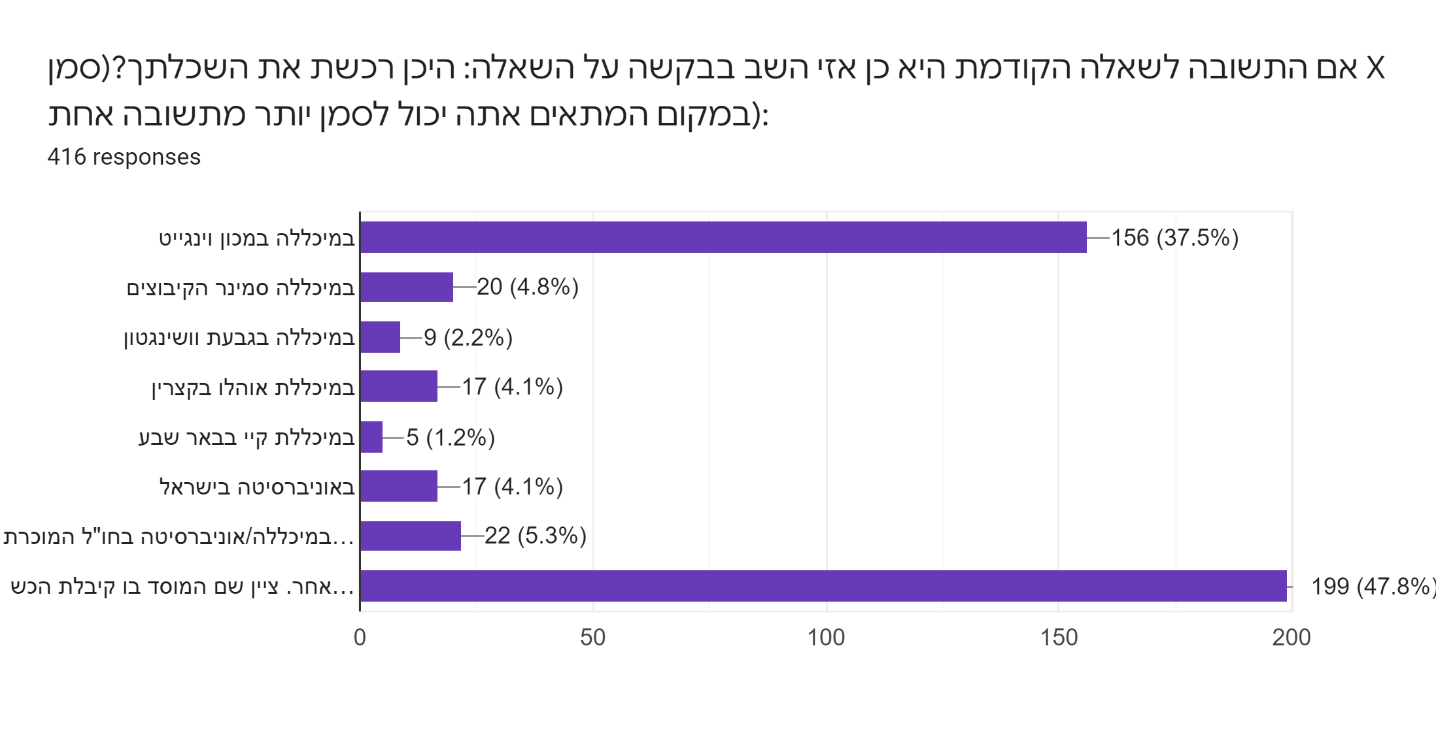
If the answer to the previous question is yes, then please indicate where you
acquired your academic education?
Wingate College
Kibbutzim college
Washington College
Ohalo college
Kay college
A university in Israel
Uni. College Abroad
Other institution

Slide 25
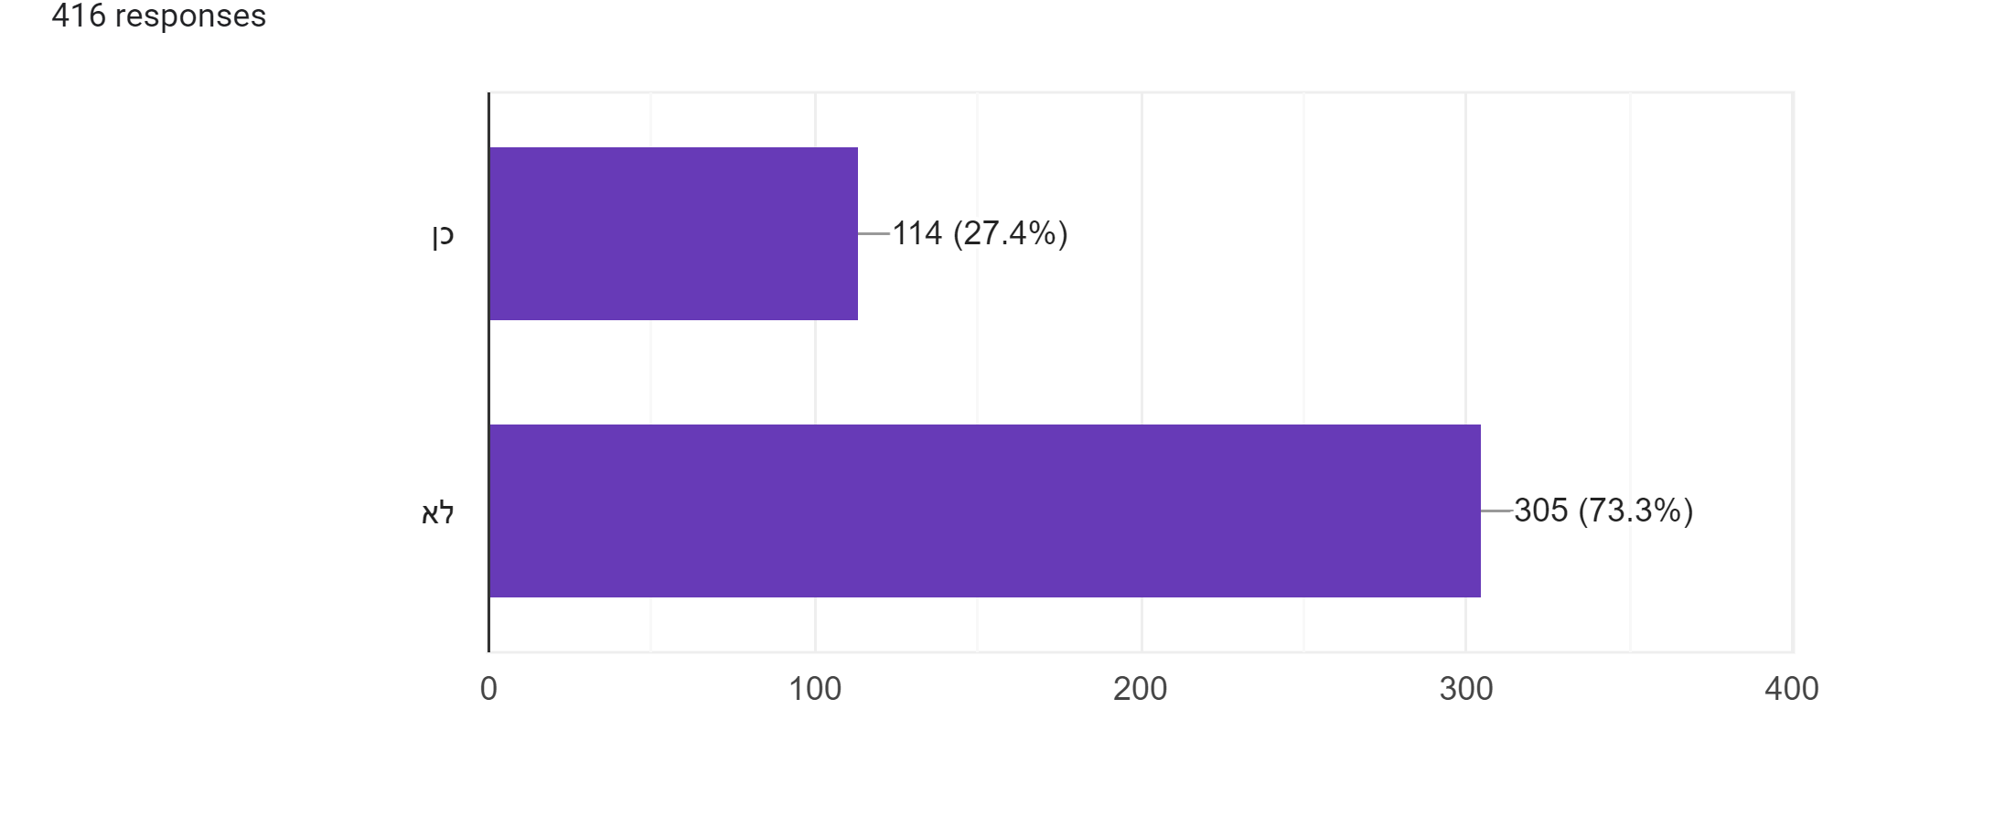
Are you a member of a coaches association today?
Yes
No

Slide 26
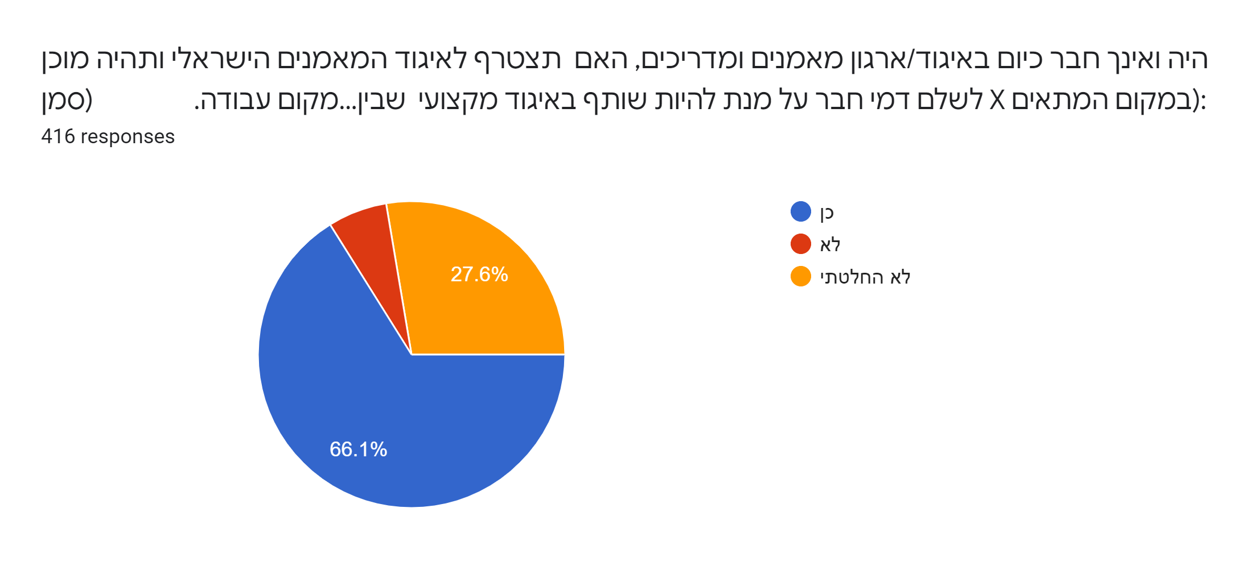
Were you or are you not currently a member of an association/organization of coaches and instructors? Would you join the Israeli Coaches Association and would you be willing to pay membership fees in order to be a member in a professional association?
Yes
No
Didn’t decide yet

Slide 27
If your answer to the previous question is "yes", then please answer the question how much money do you think the Association should charge for annual membership fees?
No more than 120 NIS
Between 120 – 150NIS
Between 150 – 180 NIS
Between 180 – 200 NIS
More than 200 NIS

Slide 28
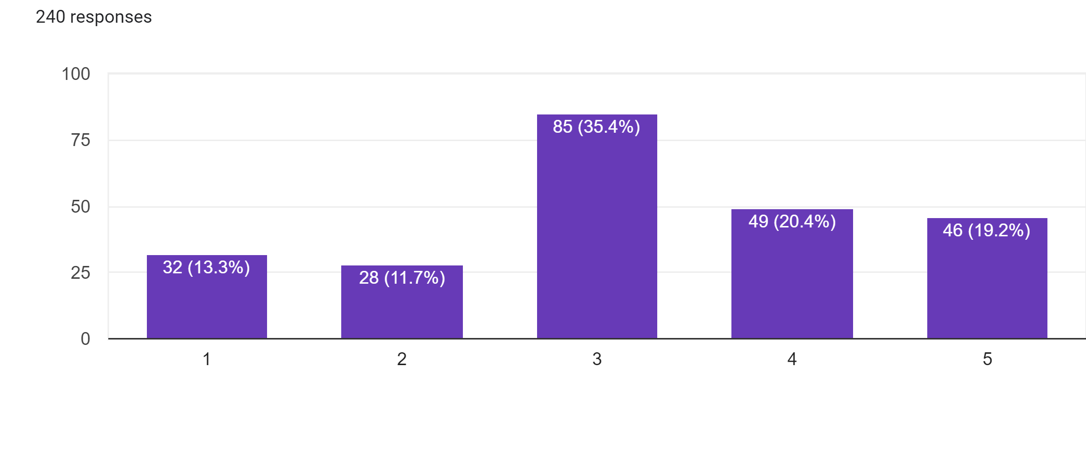
Please rate how much has the Covid – 19 pandemic affected your livelihood
Very little – 1, Very much - 5

Slide 29
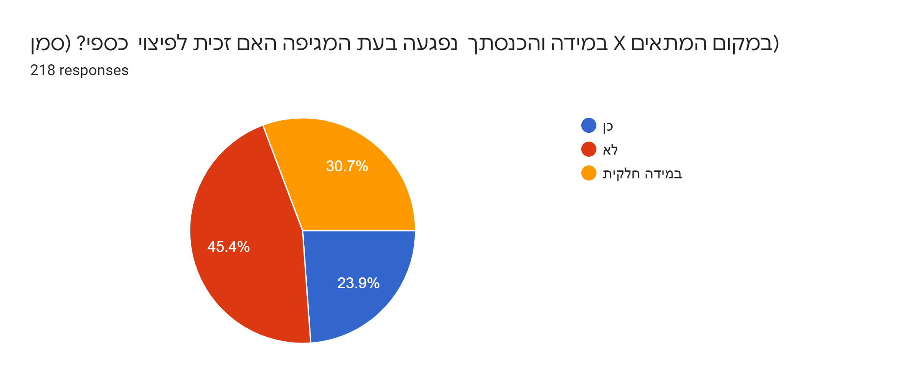
If your income was damaged as a result of the coronavirus pandemic, did you receive financial compensation?
Yes
No
Partially

Slide 30
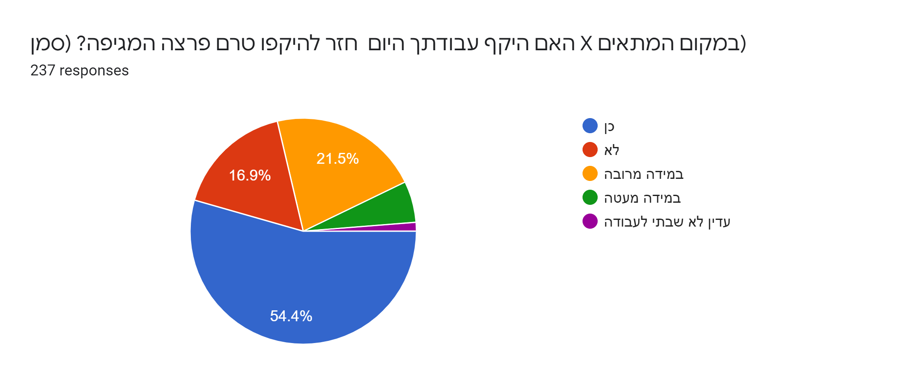
Has the scope of your work today returned to its scope before the outbreak of the pandemic?
Yes
No
To a large extent
To a small extent
Have not returned yet to work

Slide 31
If you have returned to your job as a coach / instructor, have all the athletes returned to training as before the outbreak of the pandemic?
There is a significant decrease in the number of athletes
There is a decrease in the number of athletes
There is a no change in the number of athletes
There is an increase in the number of athletes
New Coach
There is an increase in the number of athletes in the club
I changed teams
Many athletes have left but many new came

Slide 32
Is there a correlation between the employer and the employment contract?
There seems to be a connection between the employer and the employment contract.
However, because some of the groups were too small, it is not possible to infer the form unequivocal, without more participants.
X-squared = 90.652,df = 14, p-value = 2.858e-13.
Fisher simulation )based on 2000 simulations) = 0.0004998

Slide 33
Statistical Analysis
Is there a correlation between seniority and academic education?
Yes.
Academics are usually with more seniority.
The Kruskal-Wallis test revealed statistical significance. Chi-square and Fisher exact tests as well. X-squared = 25.598, df = 3. p=value = 1.158e-05

Slide 34
Is there a correlation between seniority and scope of work?
Yes.
Full-time, average seniority, is the highest. In more than a full-time job, the average seniority is lower, and in a part-time job, the average seniority is the lowest.
However, the correlation is relatively low.

Slide 35
Is there a correlation between seniority and scope of work?
Yes.
In a full-time job, the average length of seniority is the highest, whereas in a part-time job, the average length of seniority is the lowest

Slide 36
Is there a correlation between seniority and scope of work?
Yes
The Kruskal-Wallis test and Chi-squared = 28.47, df = 2, p-value = 6.573e
The Kruskal -Wallis test indicated statistical significance (referring to job scope as a category, and job as an ordinal variable; and vice versa).
When looking at the two variables as order variables, the Spearman correlation was positive (0.23), and significant. p-value= 1.453e-06. Kendall correlation also was positive (0.21), and significant. p-value 1.574e-06.
Looking at the two variables as categorical variables – X--squared = 31.731, df = 6, p-value = 1.837e-05 and Fisher (simulation) tests, p – value = 0.0004998, revealed statistical significance.

Slide 37
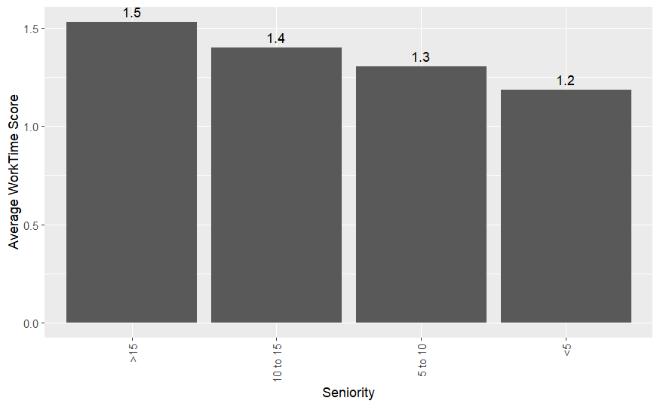
The scope of the work tends to increase as seniority increases:

Slide 38
Is there a correlation between seniority and the sports discipline?
Yes.
The findings indicate that karate, fencing, skating, shooting, boxing, and gymnastics have the most seniority, compared to archery, Krav Maga, fitness room, and netball. (catchball = mamanet) where seniority is the lowest.
The Kruskal-Wallis test and Chi-squared came out clear = 78.434,df =34, p-value – 2.289e-05

Slide 39
The findings indicate that karate, fencing, skating, shooting, boxing, and gymnastics have the most seniority, compared to Archery, Krav Maga, Gyms,
and Netball (catchball = Mamanet) where seniority is the lowest catchball.

Slide 40
Is there a correlation between seniority and the type of coaches
(HPC, Sport for All Coach, etc(?.
Yes.
The findings indicated that for HPA and National Level Athletes, the coaches have a higher seniority, than coaches of Sport For All and coaches of Young Athletes.
,

Slide 41
According to the Kruskal Wallis test, there is a significant difference between seniority and the type of coach.
The Kruskal-Wallis Chi-square = ג30.242, df = 6, p-value = 3.536e-05
On the other hand, when referring to seniority as a categorical variable, chi-square and Fisher test are significant.
X-squared = 47.004, df = 18, p-value = 0.0002114
Fisher simulation, p-value 0.0009995

Slide 42
The findings indicated that the seniority of coaches of HPA and National level, is higher than coaches of Sport For All, and Young Athletes.

Slide 43
Is there a correlation between seniority and the institution where
you acquired your education as a coach?
Yes.
It was found that graduates of the Wingate Coaching School have more seniority in coaching versus graduates of other coaching education institutions.
The Kruskal-Wallis Chi-squared = 25.557,df = 7, p-value = 0.00060043

Slide 44
Is there a correlation between the institution where you acquired your education as a coach and the level of your satisfaction with the coach education program?
Yes
The Kruskal-Wallis Chi-squared 29.763, df = 7, p-value = 0.0001049

Slide 45
Is there a correlation between the scope of the job and the
sports disciplines?
There seems to be a correlation. However, since some of the groups are too small, it is not possible to conclude unambiguously, without more participants.
Chi squared 108.12, df = 68, p-value = 0.001418. Fisher simulation p-value = 0/0009995
No correlation was found between the place of residence and the return to physical activity after the COVID -19 pandemic.
No connection was found between the sports discipline and the athletes' return to training after Covid - 19 pandemic.

Slide 46
Is there a correlation between the sports discipline and the employment agreement/work contract?
It seems so.
There are branches where it is more common to be employed, Disciplines where it is customary to be self-employed, and disciplines where it is customary to be without a contract.
X- squared = 46.778, df = 12, p-value = 5.093e06. Fisher simulation(based on 2000 simulations), p-value = 0.0004998.
However, since some of the groups are too small, it is not possible to draw a definite conclusion, without more participants.
It seems that athletics, catchall, cycling, and tennis have the most without a contract

Slide 47
Is there a correlation between the place of residence and the employment agreement and seniority?
No correlation was found between the place of residence and the employment agreement and seniority.
(In the square and Fisher tests, they came out borderline, but with Bonferroni correction, they came out non-significant.)(In the square and Fisher tests, they came out borderline, but with Bonferroni correction, they came out non-significant.)

Slide 48
For Basketball, Volleyball, Tennis and Catchtball- Coaches have the most contracts.

Slide 49
Is there a correlation between satisfaction with the Coach Education program and the sport?
Yes.
A significant difference was found in the level of satisfaction with the Coach Education Program process between sports.
Coaches in Skating, Handball, and Sambo, the level of satisfaction with the Education program is high compared to coaches in the Basketball, Fitness Room, and Sailing branches. They reported a low level of satisfaction with the process of their training as coaches.
The Kruskal-Wallis statistical test and Chi-squared = 79.518, df = 34, p-value = 1.645e-05

Slide 50
Coaches in: Skating, Handball, and Sambo, their level of satisfaction with the Education program is higher than coaches in the Basketball, Fitness Room, and Sailing branches.

Slide 51
Research – Discussion and Conclutions
In general, the findings are not uniform, and while some of the answers reveal statistically significant replies, in another part of the answers no significant differences were found, probably due to the relatively small number of participants in certain sport disciplines.
In some of the answers it appears that there is a tendency towards significant findings, but due to the relatively small number of participants in the survey, it is not possible to determine with certainty the direction of the findings.

Slide 52
Research – Discussion and Conclutions
It was indicated that the level of Seniority is related to a number of variables tested in the survey.
Seniority in coaching seems to play a significant role in the Coach’s work. The academic degree, the institute/school where the coach acquired his/her Coaching Diploma, the scope of work, and the level - type of trainee are all related to Seniority and were found significant
It means, as the cliché’ says: The experience is many times the best teacher however sometimes the tuition is high.
in coaching, there are no shortcuts. Furthermore, A more in-depth examination of the relationship between seniority at work and the place where you acquired your education as a coach reveals that many academic coaches are physical education teachers and therefore there is a c connection to sports coaching

Slide 53
Research – Discussion and Conclutions
The answers related to academic degrees, in which we found significant differences, revealed that coaches with an academic degree have more seniority versus coaches without an academic degree.
One explanation is that coaches in Israel have already chosen the profession from which they will make a living and strive to continue working in the field of coaching that they love. Also, the majority of the academics among the coaches are physical education teachers so the field of sports and physical activity created ideal working conditions for them.

Slide 54
Research – Discussion and Conclutions
The subject of the employment agreement was found to be statistically significant. Basketball, volleyball, tennis, and catchball coaches have more employment agreements compared to coaches in other sports that participated in the survey.
The significant results we found regarding the existence of an employment agreement in the fields of Basketball, Volleyball, Tennis, and Catchball compared to the other branches, can be explained by the fact that these sports disciplines are popular in Israel and they also generate income into the employer’s coffers, versus other sports except Football which is the most popular sport in Israel but the coaches did not participate in the survey and the swimming coaches who did not participate due to a dispute with the Swimming Association.

Slide 55
Research – Discussion and Conclutions
The findings also show that the place where the coach acquired his education is related to seniority in coaching. The findings revealed at a statistically significant level that those coaches who acquired their education at the Wingate Institute have more seniority in sports training.
These findings can indicate the centrality and special status of the Wingate Institute, the National Sports Institute in Israel. Those who have made an effort to be admitted to the coaching school at the institute, those who are willing to travel long distances to study - are interested in seeing coaching as a profession and career, that they will focus on throughout their lives, more so than coaches who acquired their coaching diploma from other coach education institution.

Slide 56
Research – Discussion and Conclutions
The significant findings regarding the level of satisfaction of the coaches, by sports, and the coach education program indicate that the sports of sambo, handball, and roller skating have a higher level of satisfaction with the coaching education process compared to coaches in basketball, gyms, and sailing. One of the explanations for the differences is probably related to who coordinated the studies in these branches and the content of the studies.
Sailing and basketball are leading sports in Israel's high-performance sports, and therefore the critical level of the training is higher than other sports disciplines. It meets the level required of the coaches in these sports.
In the field of gyms, which is a common field in Israel, it is necessary to check what is the reason why the coaches - the graduates are not satisfied with the contents of the various courses

Slide 57
Summary and Recommendations
This is the first comprehensive survey conducted in Israel about the demographic, educational, and occupational characteristics of the coaches and their work.
These findings are a basis for understanding the coaching process and the work of the coaches in Israel, which will enable policymakers to improve the coaching conditions, coach education programs, and in-service training.
It is assumed that presenting the findings to policymakers such as the Ministry of Culture and Sports, the Coaching Division, the Olympic Committee, etc, will help advance the knowledge and status of the coaching profession and coaches in Israel.
We recommend performing similar research in the future in order to learn about trends and changes, if any, in the characteristics of the coaches' work in Israel.

